Slide 1






CS4153.O22.CTTT
MOBILE APPLICATION FOR A ONLINE SHOP
Subject : Mobile Application Development
Lecturers: Ph.D Nguyen Thanh Binh
Tran Vinh Khiem
Group Members:
Nguyen Minh Thanh - 20521920
Nguyen Van Tan - 20521880

Slide 2

Table content
1 . Introduction
6. Features List
2 . Litterature Review
7. Project Structure
3 . Target
8. UX/UI
4. Technology
9. Demo
5. System Architecture
10. References

Slide 3


Introduction
Context
Current Works
Problem
Target

Slide 4
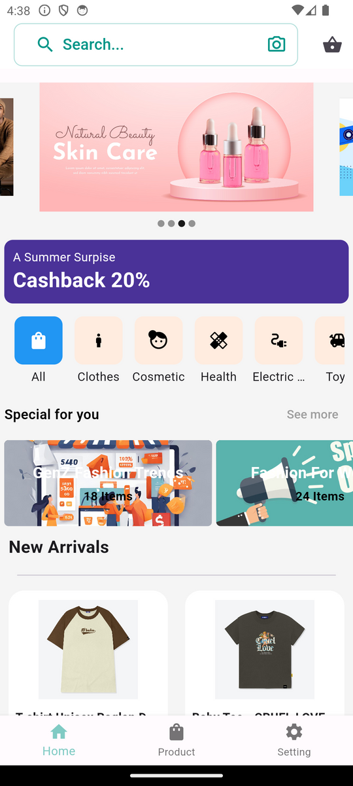

Introduction
Online buying behavior has become an integral part of many people's lives.
According to Vietnam's White Book of E -commerce 2023, 61% of online buyers are through e -commerce app, 55% via social networks , ...
In particular, up to 91% of online consumers using mobile phones as ordering tools, 55% via social networks
Introducing Estore, an shopping application can help small and medium enterprises participating in this market

Slide 5
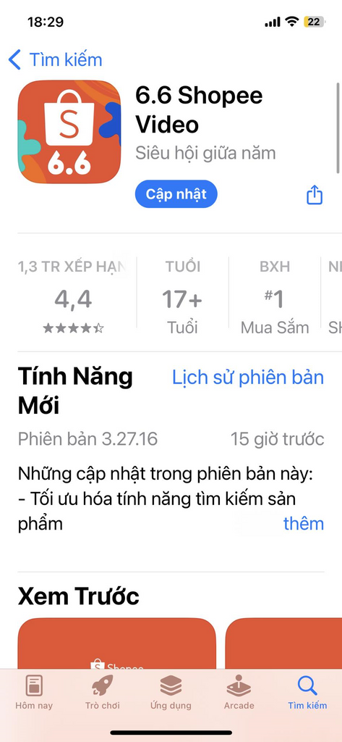
Literature Review
1
Shopee
2
Tiktok Shop
The No. 1 shopping app in Appstore
Ranked 3rd in the e -commerce market in Vietnam in 2022.
Released in 2015
Released in 2022
Support promotional, communication or marketing policies for shop
Tiktok Shop inherits a huge number of users from Tiktok
--> Rampant poor quality goods, causing many dumping problems
--> The conversion rate depends on traffic
--> Annual trading floor fee, causing many disadvantages for the seller
--> The emotions of customers when watching videos or livestream sales

Slide 6
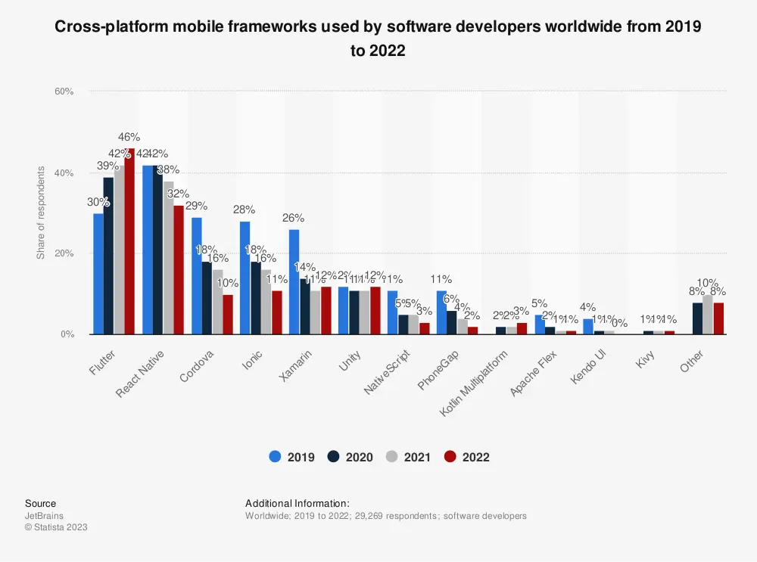
Literature Review

Slide 7
Target
Additional
Tracking Order In Real Time
Enhancing user experience with modern UX/UI design
Integrate with 3rd party services
Core Features
Build an application with full basic features

Slide 8






Technology
Languages
Framework
Dart
SQL

Slide 9









Technology
Stimulation
Third Party
Android Studio
VS Code
Libaries

Slide 10
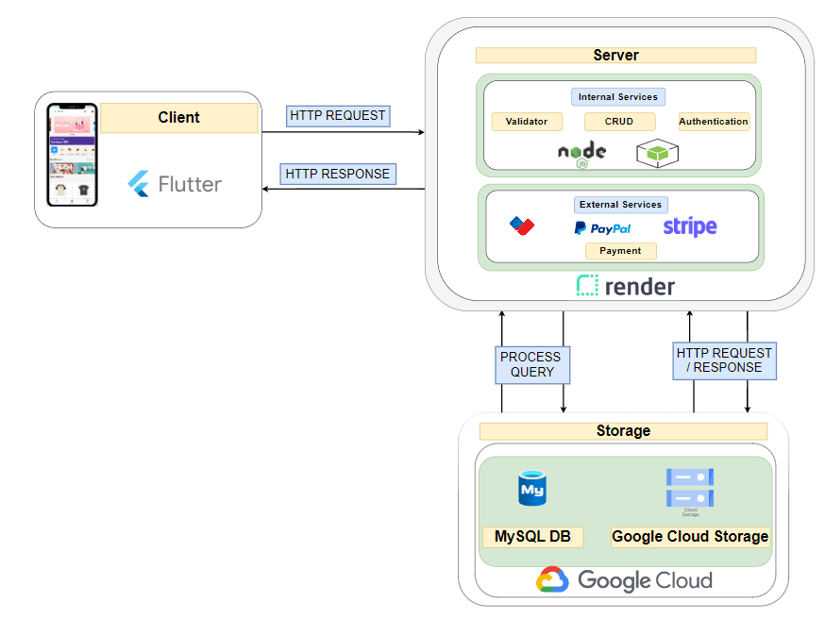
System Architecture

Slide 11
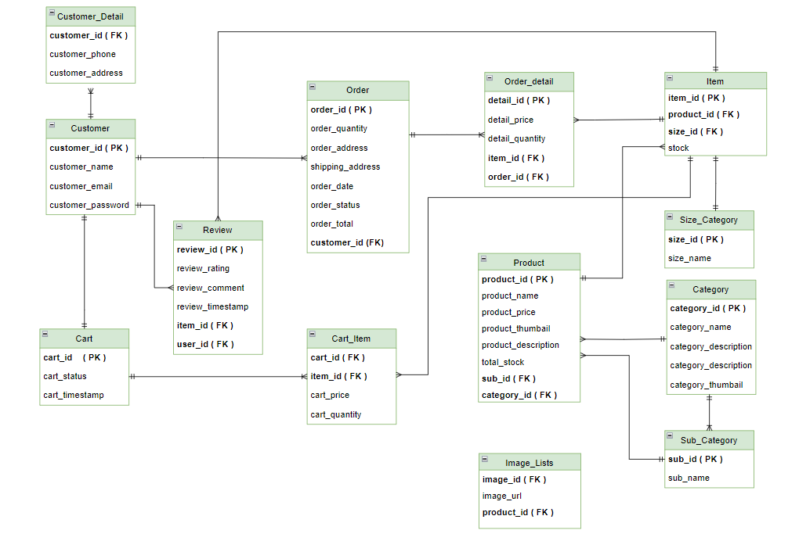
Database Design

Slide 12
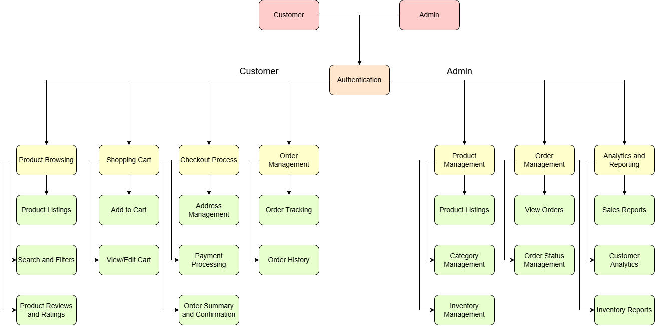
Features List

Slide 13
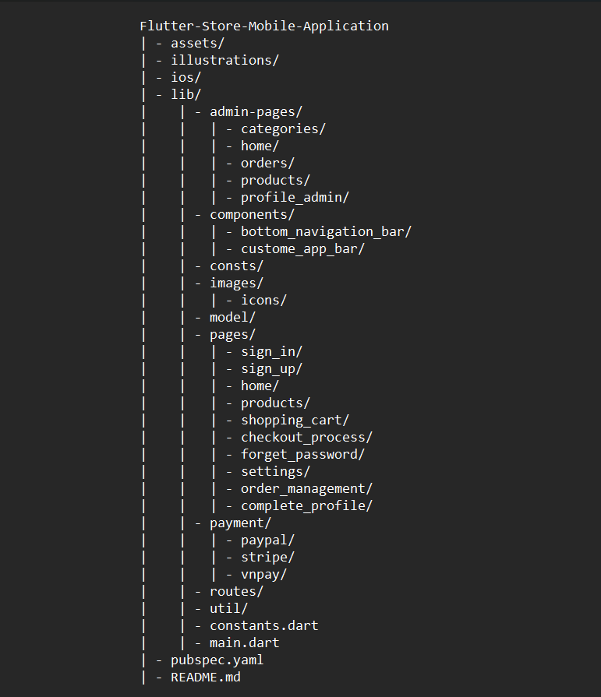
Project
Structure
Front-end

Slide 14
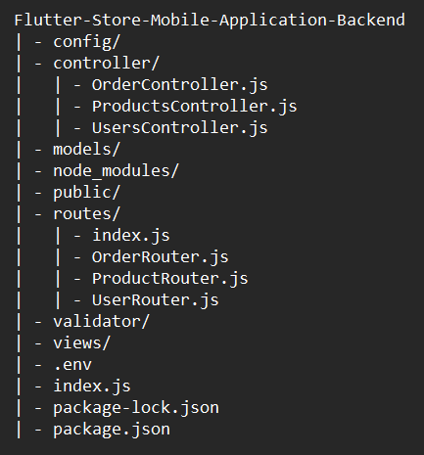
Project Structure
Back-end

Slide 15
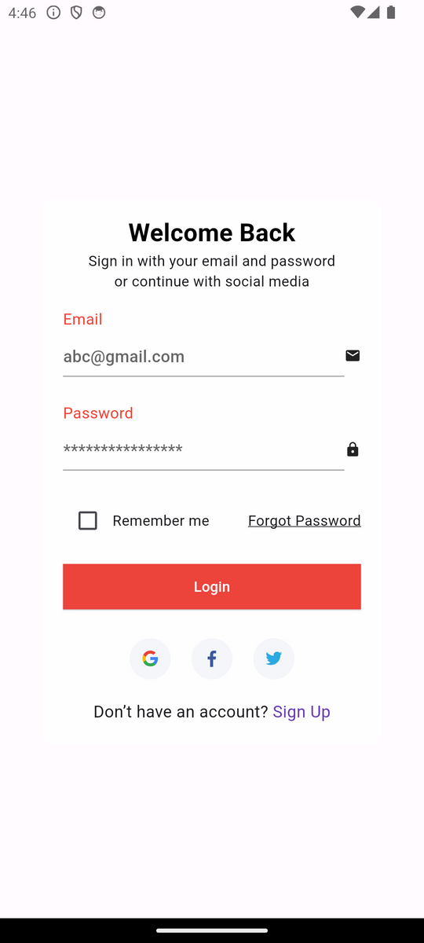
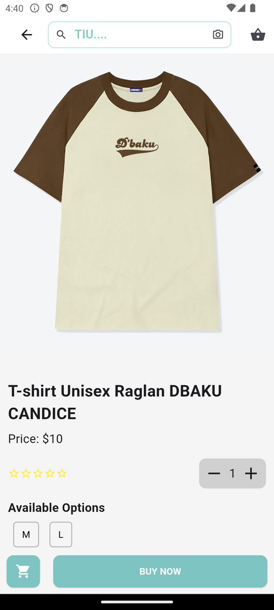
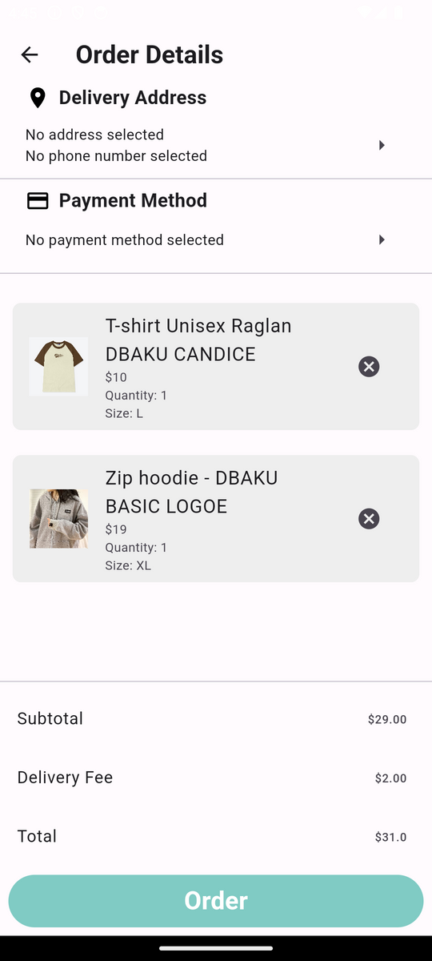
UX/UI | CUSTOMER
Sign in
Home
Product
Checkout

Slide 16
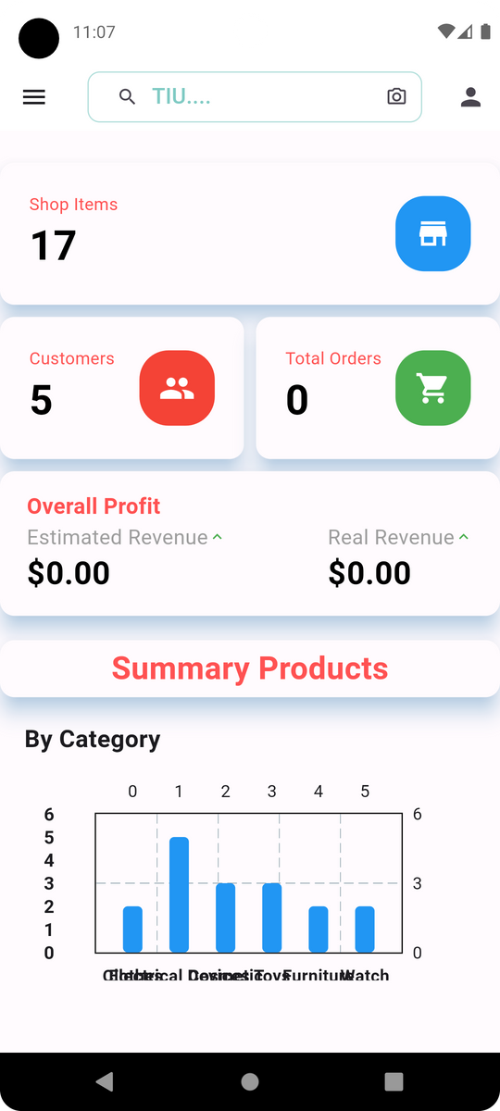
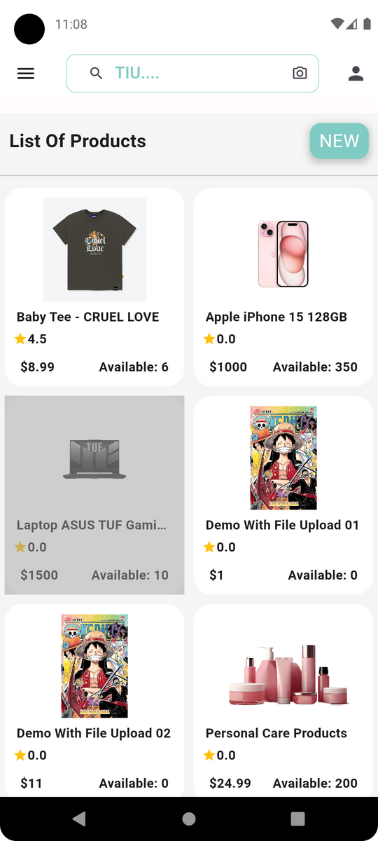
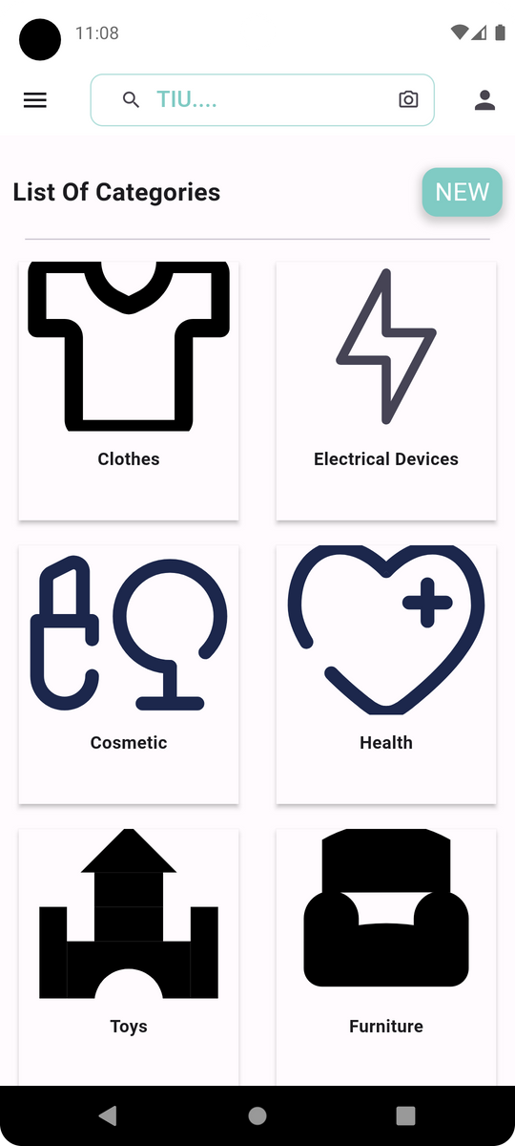
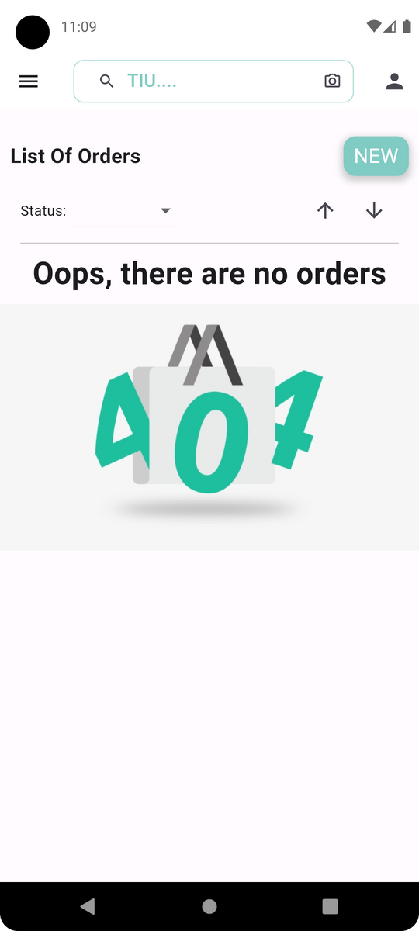
UX/UI | ADMIN
Dashboard
Product
Category
Order

Slide 17
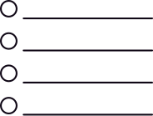

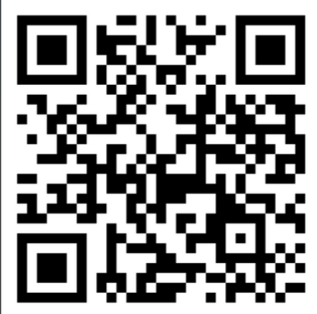
Demo
Sign in
Browse products
Add to Cart
Checkout

Slide 18
Future Enhancement
Integrated recommended systems
Modified the UI/UX for match with trending design

Slide 19
Source Code
Frontend
Backend
Github:
Github:
https://github.com/MinhTh2nh/Flutter-Store-Mobile-Application-BackEnd
https://github.com/MinhTh2nh/Flutter-Store-Mobile-Application
https://github.com/nguyentaan/vnpay_be

Slide 20
References
[1] Mitch Koko | Grocery Shop App • Flutter Tutorial (Video)
[2] Flutter Mapp | Flutter Tutorial For Beginners in 3 Hours (Video)
[3] Flutter documentation (docs)
[4] Github: rahul-badgujar/EShopee-Flutter-eCommerce-App (repo)
[5] Flutter’s package documentation (pub.dev)
[6] Integrated Paypal sandbox
[7] Integrated VNPay sandbox
[8] Integrated Stripe sandbox
[9] Upload images into google cloud storage || Creative Bracket

Slide 21
QUESTIONS
&
ANSWER

Slide 22
THANK
YOU

